Slide 1
MACHINE LEARNING
A structured introduction

Slide 2
AGENDA
Recent examples of Machine Learning
Definition and promises of Machine Learning
The framework for this workshop
“The problem side”
“The solution side”
Training (“fitting”), validating and testing
Model Selection
Wrap-up

Slide 3
SCOPE OF THIS LEARNING SESSION
Recent examples of Machine Learning
Definition and promises of Machine Learning
The framework for this learning session
“The problem side”
“The solution side”
Training (“fitting”), validating and testing
Wrap-up

Slide 4
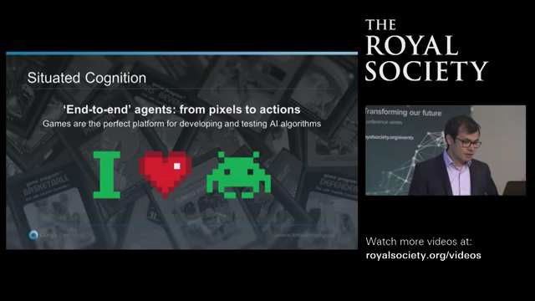
Recent example of Machine Learning
An algorithm that has learnt to play arcade games – better than any human…
You can find the video here:
https://youtu.be/g-dKXOlsf98
Please also note that DeepMind recently also published a video on the game “Go”.
Notes:
Demmis Hassabis (Deep Mind Founder)

Slide 5
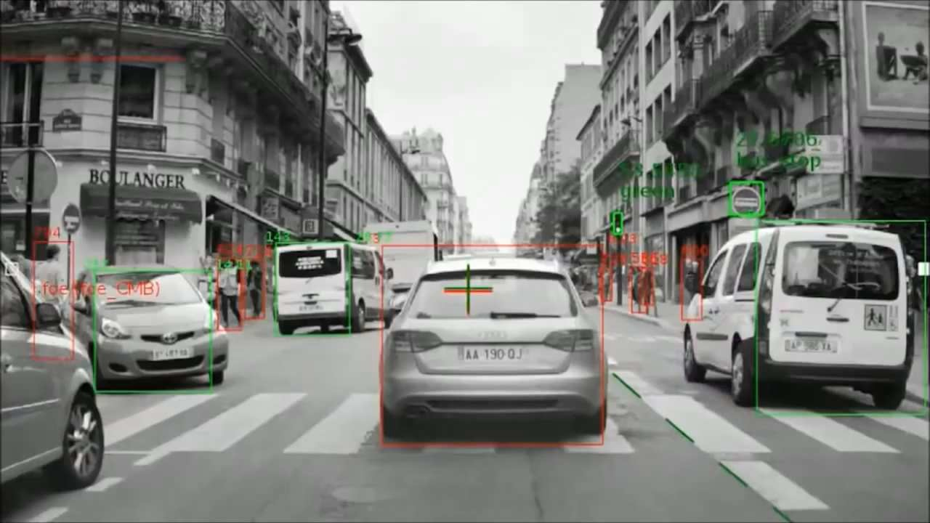
Recent example of Machine Learning
What an autonomous car sees…
You can find the video here:
https://youtu.be/kp3ik5f3-2c
Source: The Future of Computer Vision and Automated Driving by Prof. Amnon Shashua (mobileye)

Slide 6
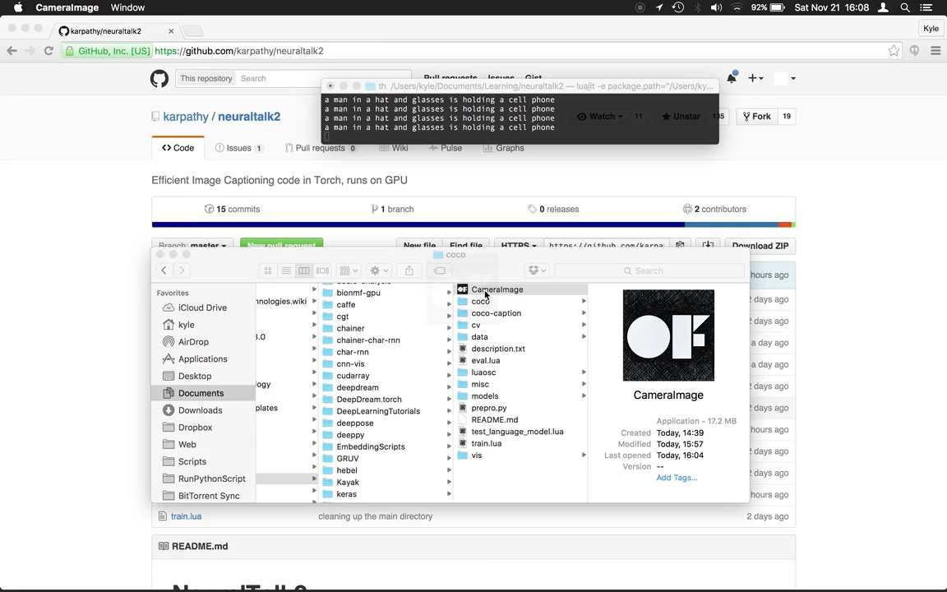
Recent example of Machine Learning
Descriptions generated in real-time by a neural network during a brief walk around Amsterdam…
You can find the video here: https://vimeo.com/146492001

Slide 7
AGENDA
Scope of this workshop
Recent examples of Machine Learning
Definition and promises of Machine Learning
The framework for this learning session
“The problem side”
“The solution side”
Training (“fitting”), validating and testing
Model Selection
Wrap-up

Slide 8
Definition and promises of Machine Learning
Machine Learning allows computer programs to improve their performance with experience – without being explicitly programmed
A useful definition of Machine Learning
“Learning is any process by which a system improves performance from experience.”
Herbert A. Simon (Nobel laureate and computer scientist)
“A computer program is said to learn to perform a task T from experience E, if its performance at task T, as measured by a performance metric P, improves with experience E over time.”
“Machine Learning”, Tom Mitchell, 1997
“[Machine Learning is the] Field of study that gives computers the ability to learn without being explicitly programmed.”
Arthur Samuel (computer gaming and A.I. pioneer), 1959

Slide 9

Definition and promises of Machine Learning
The promises of Machine Learning range from “automating discovery“ in science…
“Machine learning is the scientific method on steroids. It follows the same process of generating, testing, and discarding or refining hypotheses.
But while a scientist may spend his or her whole life coming up with and testing a few hundred hypotheses, a machine-learning system can do the same in a fraction of a second. Machine learning automates discovery. It’s no surprise, then, that it’s revolutionizing science as much as it’s revolutionizing business.”
“The Master Algorithm”, Pedro Domingos (University of Washington)

Slide 10
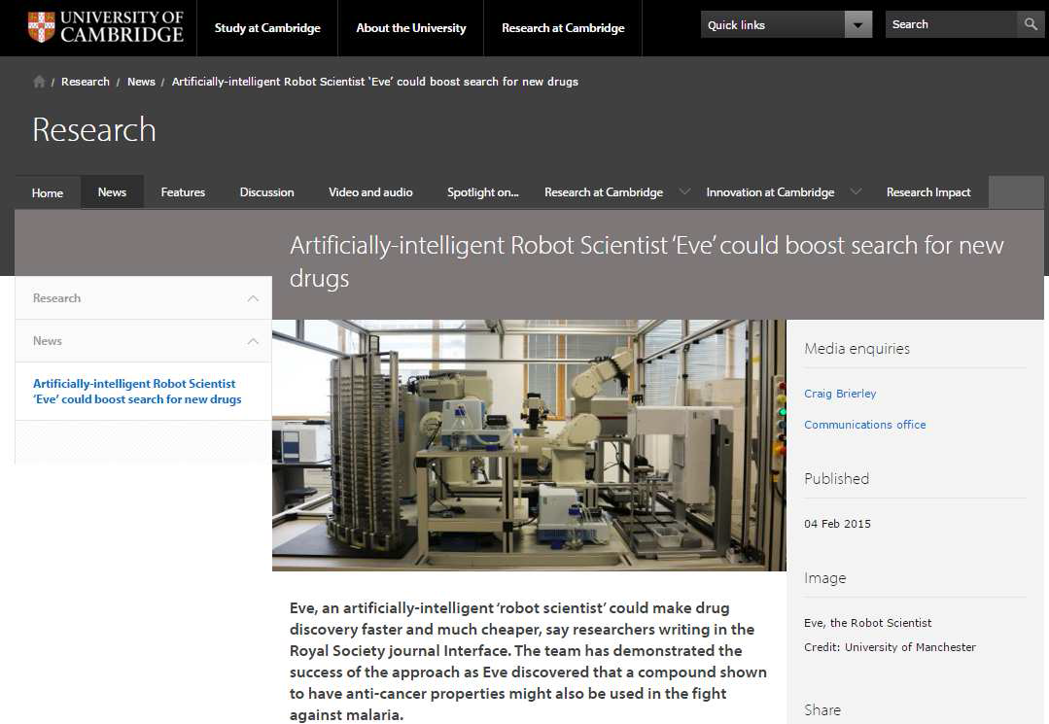
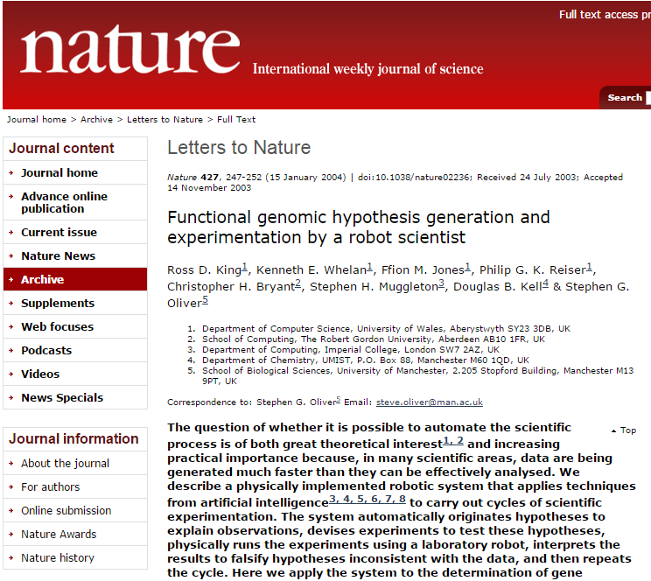
Definition and promises of Machine Learning
Researchers use “Robot scientists” in an attempt to automate the scientific process
Cambridge University link: http://www.cam.ac.uk/research/news/artificially- intelligent-robot-scientist-eve-could-boost-search- for-new-drugs
Nature link: http://www.nature.com/nature/journal/v427/n6971/ full/nature02236.html

Slide 11

Definition and promises of Machine Learning
..to “solving intelligence” itself
“Our mission at DeepMind is very easy to articulate – but obviously quite hard to do. And we usually describe it as a two-step process: Step 1: Solve intelligence; …and then…
Step 2: Use it to solve everything else.”
Demis Hassabis (Google DeepMind), 2015

Slide 12
Definition and promises of Machine Learning
What are reasons why Machine Learning has gained popularity in recent years?
Reasons: (probably not exhaustive):
Data availability
availability of massive amounts of data (unlabelled & labelled via MTurk) cost-effective storage of huge amounts of data
Realization that the stored data is actually valuable so massive amounts of data are actually stored
Computing power Faster processors Parallel processing
use of GPUs instead of CPUs
computing clusters / cloud computing (e.g. EC2) – computing as a service
With the rise of efficient GPU computing, it has become possible to train neural networks with many layers (deep learning).
Advances in algorithms / toolkits
e.g. the old idea of neural networks that has been revived multiple times & is now probably one of the most impressive methods
fully-fledged and highly optimized libraries that can be used (Python, R, …)
New libraries published every few days: TensorFlow by Google; etc

Slide 13
AGENDA
Scope of this workshop
Recent examples of Machine Learning
Definition and promises of Machine Learning
The framework for this learning session
“The problem side”
“The solution side”
Training (“fitting”), validating and testing
Model Selection
Wrap-up

Slide 14

































The framework for this workshop
To prevent anyone from getting lost, we will use this framework to structure the landscape of Machine Learning
Problem side
A Types of (Machine) learning
B
Types of (Machine Learning) problems
Types of (Machine) learning methods
C
“Base learners” (= individual learning methods); families of
algorithms are inspired by different schools of thought
B
Solution side
…
…
…
…
…
…
…
…
…
…
“
E
n
s
e
m
b
l
e
m
e
t
h
o
d
s
”
B
(
=
u
s
e
m
u
l
t
i
p
l
e
d
i
f
f
e
r
e
n
t
B
f
m
o
d
e
l
s
o
f
t
h
e
s
a
m
e
o
r
B
d
i
i
f
f
e
r
e
n
t
b
a
s
e
l
e
a
r
n
e
r
a
n
d
co
m
b
i
n
e
t
h
e
i t
r
o
u
p
u
t
s
)
…
…
…
…
…
…
…
…
…
…

Slide 15
AGENDA
Scope of this workshop
Recent examples of Machine Learning
Definition and promises of Machine Learning
The framework for this learning session
“The problem side” ➔ Types of learning
“The solution side”
Training (“fitting”), validating and testing
Model Selection
Wrap-up

Slide 16
The problem side ▶ Types of learning
Question to you: How does one learn? How did you learn as a child? How do you teach an animal what to do?

Slide 17

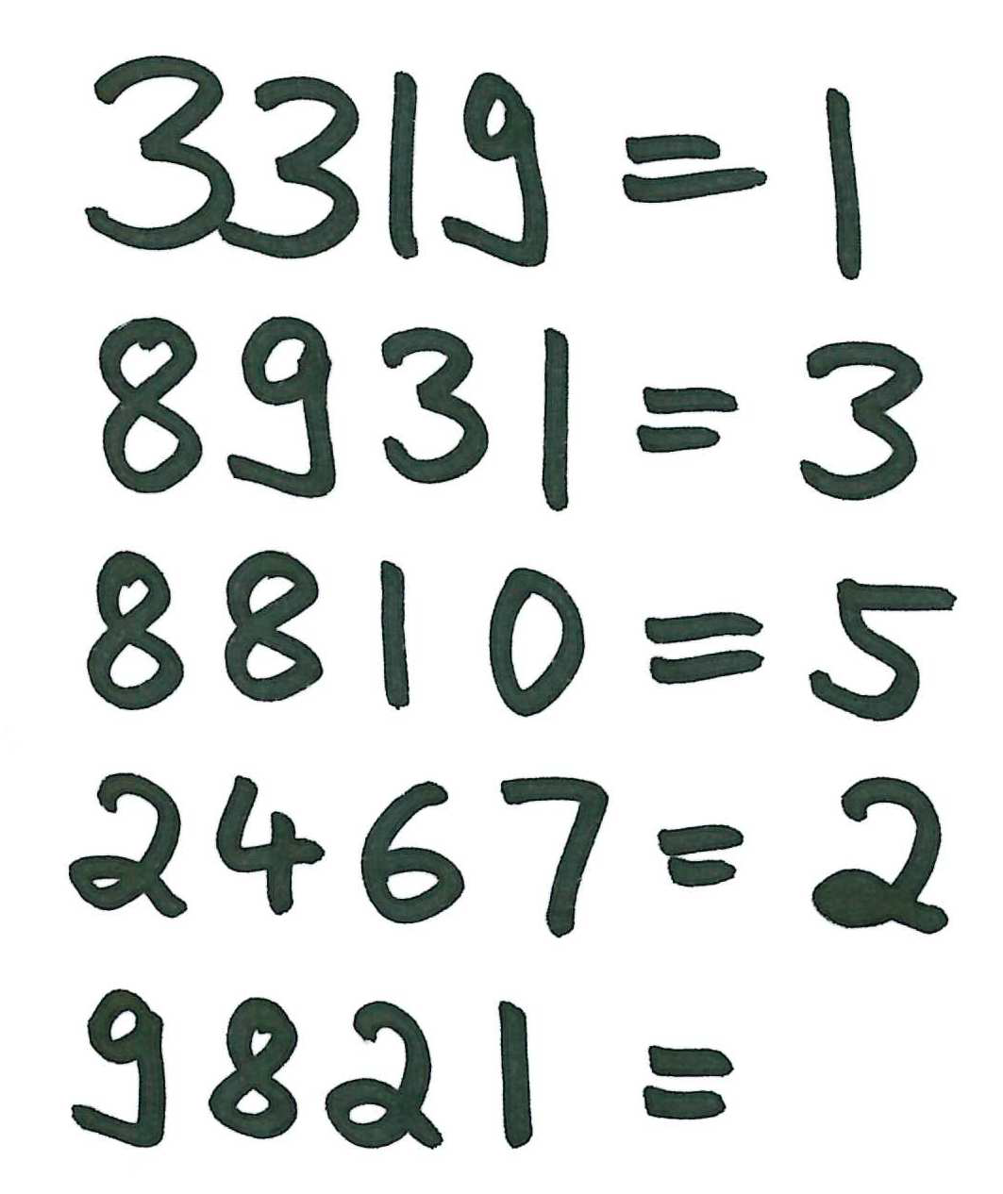
The problem side ▶ Types of learning
Question to you: How does one learn? How did you learn as a child? How do you teach an animal what to do?
1 The first type of learning
= Yes
= No
= Yes
= …
4
What could be a possible answer for the new example?
W
h
a
t
c
o
u
l
d
b
e
a
p
o
s
s
i
b
l
e
a
n
s
w
e
r
f
o
r
t
h
e
n
e
w
e
x
a
m
p
l
e
?

Slide 18









The problem side ▶ Types of learning
Question to you: How does one learn? How did you learn as a child? How do you teach an animal what to do?
1 The first type of learning
1
By generalizing
from examples + correct answers
You are given examples with the correct answer
From this you infer some form of rules (you generalize)
Labels
= Yes
= No
– Actually, before you infer the rules, you extract features (like color, shape, number of edges, etc.)
Feature extraction
Then you apply these rules to a new example in order to predict the answer
If you get a new correct answer, you can correct your rules and get even better
Remarks:
Color
Number of corners
Shape
Size of surface area
Position
Orientation
 …
Relation between presence of certain features and the label
Do I have enough examples to derive the relation?
Have I considered the right ‘features’ to derive the relation?

Slide 19

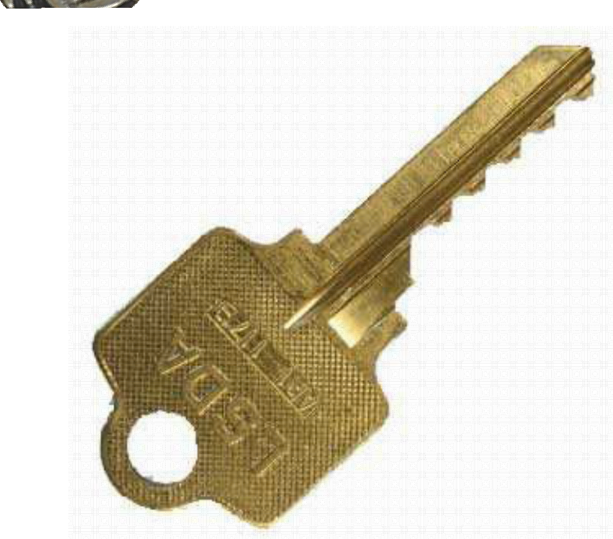
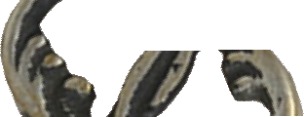

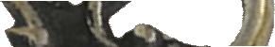
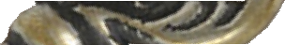
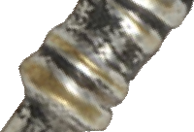
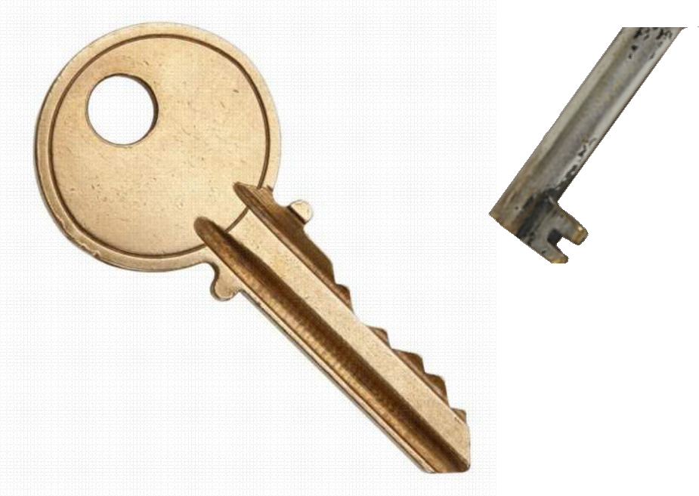
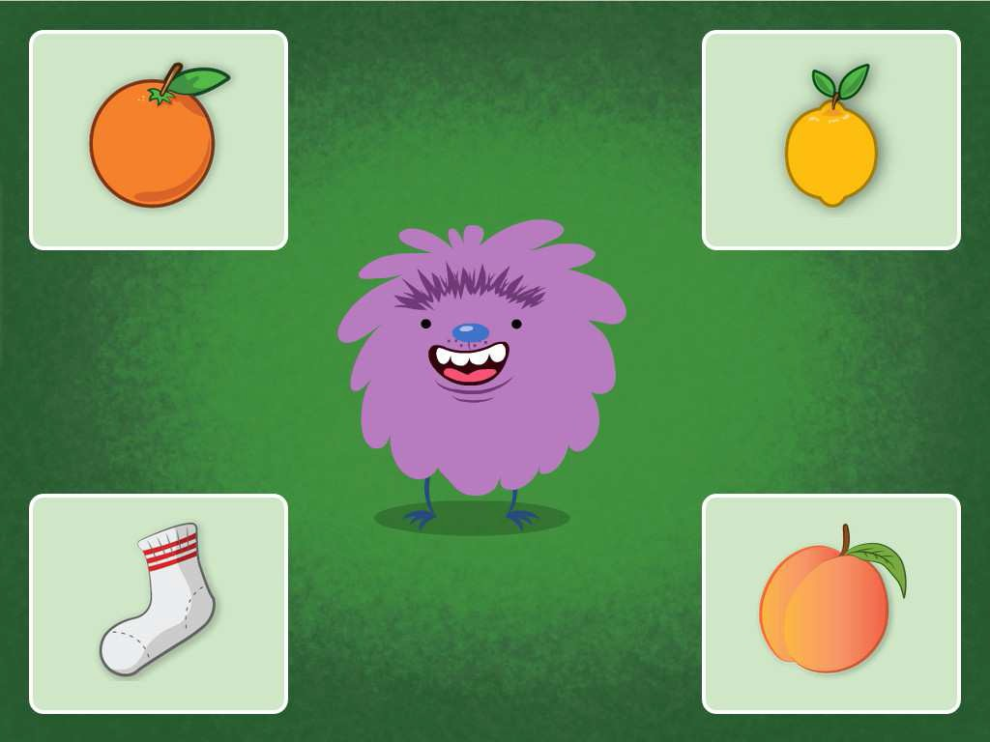



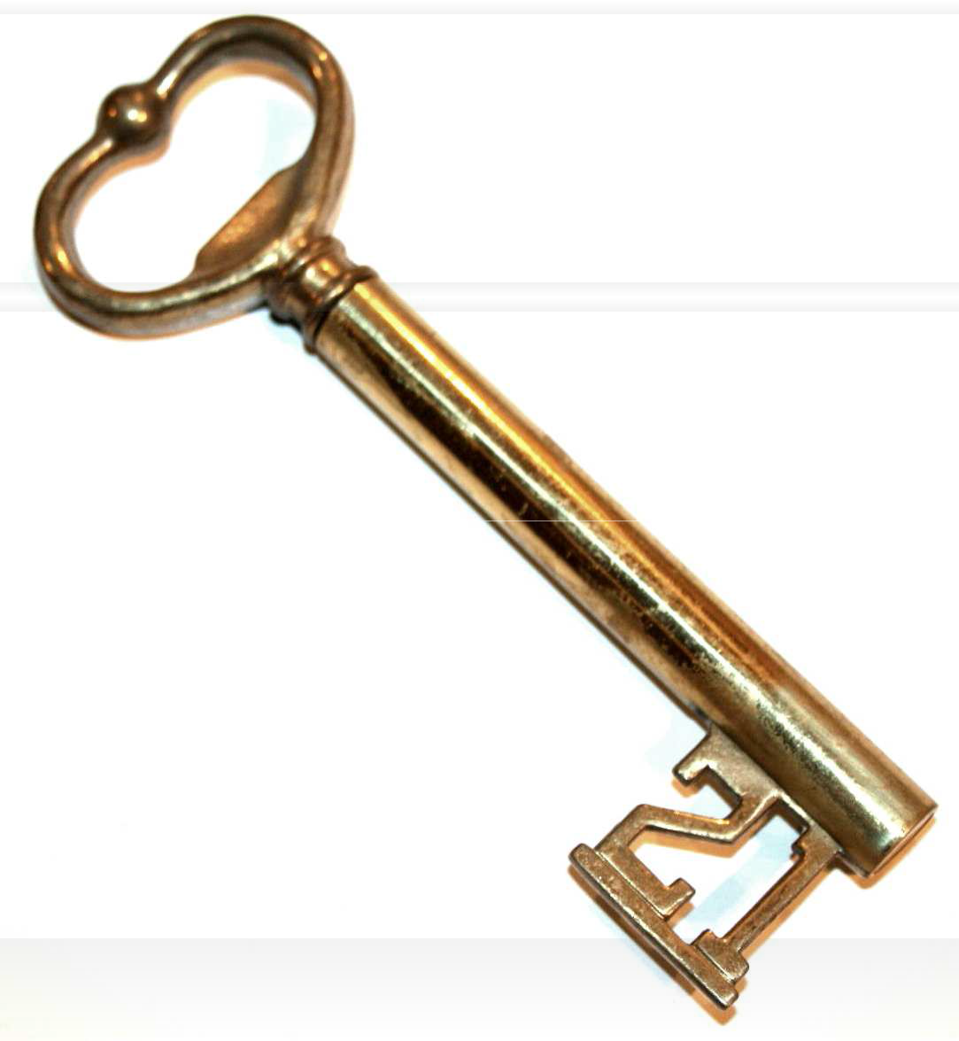

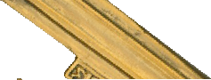



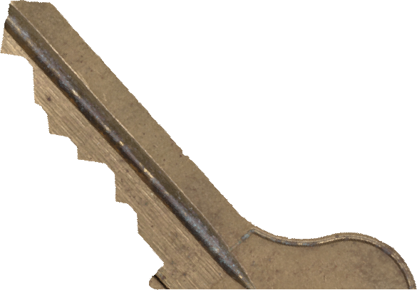
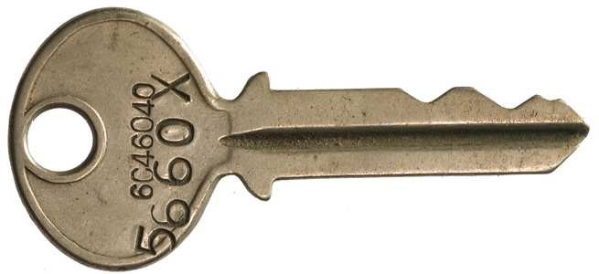



The problem side ▶ Types of learning
Question to you: How does one learn? How did you learn as a child? How do you teach an animal what to do?
2 The second type of learning
2
By comparing
You look at the things around you, compare them, arrange them according to similarity and then gain some insights (groups of similar items, odd ones, somehow important ones …)
For this, you do not need the „right“ answer; it might even be difficult to define the “right” answer
Remarks:
Do I have enough examples to understand what similar means?
Do I consider the right things (the right features) when I say two things are similar?
How do I know how many groups you want?
Source: education.com
Please create groups of similar keys.
One of the things is not like the others.
Find the thing that doesn’t belong.

Slide 20
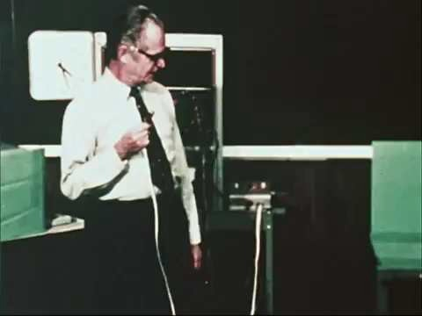



The problem side ▶ Types of learning
Question to you: How does one learn? How did you learn as a child? How do you teach an animal what to do?
3 The third type of learning
You can find the video here:
https://youtu.be/TtfQlkGwE2U
The paper 'Superstition' in the pigeon got published by Skinner in 1948:
Skinner B.F. (1948). 'Superstition' in the pigeon., Journal of Experimental Psychology, 38 (2) 168-172. DOI: 10.1037/h0055873

Slide 21
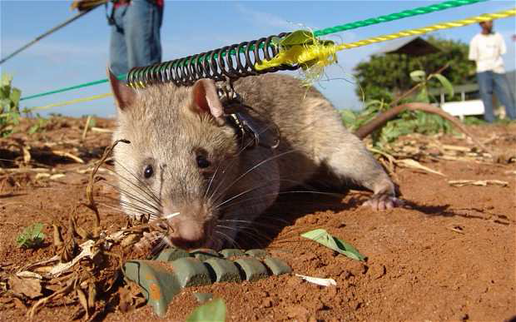
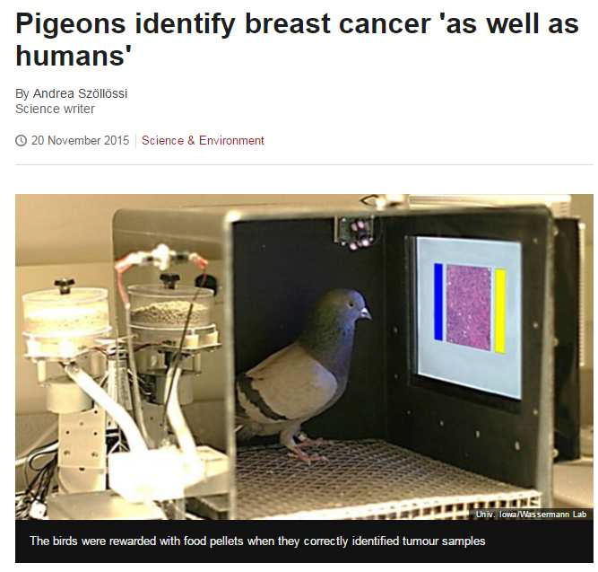
The problem side ▶ Types of learning
Question to you: How does one learn? How did you learn as a child? How do you teach an animal what to do?
3 The third type of learning
You can find the video about rats sniffing out land mines here: https://youtu.be/nEm5zR1IND0
3
By feedback (reward signal)
I don‘t tell you what or how to do it.
I don‘t give you any examples at the beginning.
But I will tell you after you have done something good (delayed feedback)
I might also tell you how good you have been (smaller or bigger award)
So I use some reward to reinforce behavior that should be maintained or increased
Other examples: Learning how to walk, riding a bike, …
Remarks:
Ok, this takes ages.
How complex can the behavior get if you just get a reward signal?
Very complex.
You can find the video about pigeons identifying cancer here: https://www.youtube.com/watch?v=flzGjnJLyS0

Slide 22





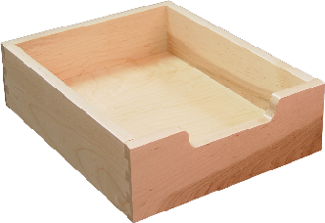
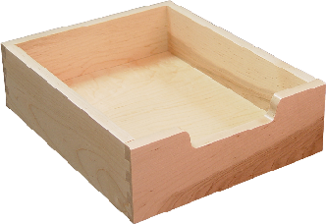




The problem side ▶ Types of learning
Quiz: Which of the following problems is which Machine Learning type?
Face recognition
(“Who is the person on this photo?“)
Customer segmentation
(“What types of customers do we have?“)
House price estimation
(“How much is this house worth?“)
Fraud detection
(“Is there anything fishy going on with this client’s credit card transactions?“)
Spam filter
(“Is this email spam?“)
Recommendation system
(“(How) will a customer like this movie?”)
Identifying handwritten characters
(“Which character is that supposed to be?”)
Training a robot how to juggle or fly stunt manoeuvres in a helicopter
Supervised Learning
Unsupervised Learning
Reinforcement Learning

Slide 23

The framework for this talk
In our framework, we have now covered the 3 general types of (Machine) learning and can now move on to the most common types of problems
Problem side
T
y
p
e
s
o
f
(
M
a
c
h
i l
A
n
e
)
e
a
r
n
i
n
g
 
S
u
p
e
r
v
i
s
e
d
U
n
s
u
p
e
r
v
i
s
e
d
R
e
i
n
f
o
r
c
e
m
e
n
t
L
e
a
r
n
i
n
g
L
e
a
r
n
i
n
g
L
e
a
r
n
i
n
g
B
Types of (Machine Learning) problems

Slide 24
AGENDA
Scope of this talk
Recent examples of Machine Learning
Definition and promises of Machine Learning
The framework for this talk
“The problem side” ➔ Types of Machine Learning Problems
“The solution side”
Training (“fitting”), validating and testing
Model Selection
Wrap-up

Slide 25
The problem side ▶ Types of Machine Learning problems
Let us do the same with classification
Overview of ML problems
Not exhaustive
Machine Learning
General types of learning
Supervised learning
“Here is the data set where the right answers (labels) are given for each example. Please produce more right answers.”
Unsupervised learning
“Here is the unlabelled data. Please find peculiarities, similarities or structures (e.g. clusters) in the data yourself.”
Reinforcement learning
“Learn to do something yourself purely by maximizing your expected reward.”
General types of problems
Regression
“Predict a continuous valued output.”
Clustering
„Group similar examples into subsets – called clusters“
…
Classification
“Predict a discrete valued output (e.g. a label or a class)”
Dimensionality reduction
„Maybe you don‘t need all the data. What is the essence of the data?“
This can be a goal on its own but is often used as a pre-processing step for other ML tasks
…

Slide 26








The problem side ▶ Types of Machine Learning problems
Quiz: Which of the following problems is which Machine Learning problem?
Face recognition
(“Who is the person on this photo?“)
Image segmentation based on color
(“Tell me which areas have a similar color”)
Prediction of future stock prices
(“What is this stock worth in the future?”)
Image compression of medical images (“Please reduce image size without losing important information”)
ICD-10 coding
(“Given this this medical diagnosis, which are the right ICD-10 codes?”)
Donut demand prediction
(“How many donuts will I sell on a Monday, 02. January?”)
Regression problem? Classification problem?
Clustering problem?
Dimensionality reduction problem?

Slide 27
The problem side ▶ Types of Machine Learning problems
Let us have a closer look at a regression…
Overview of ML problems
Not exhaustive
Machine Learning
General types of learning
Supervised learning
“Here is the data set where the right answers (labels) are given for each example. Please produce more right answers.”
Unsupervised learning
“Here is the unlabelled data. Please find peculiarities, similarities or structures (e.g. clusters) in the data yourself.”
Reinforcement learning
“Learn to do something yourself purely by maximizing your expected reward.”
General types of problems
Regression
“Predict a continuous valued
Clustering
„Group similar examples into subsets – called clusters“
…
output.”
Classification
“Predict a discrete valued output (e.g. a label or a class)”
Dimensionality reduction
„Maybe you don‘t need all the data. What is the essence of the data?“
This can be a goal on its own but is often used as a pre-processing step for other ML tasks
…

Slide 28
The problem side ▶ Types of Machine Learning problems
We illustrate regression problems by plotting the response variable as a function of some feature(s)
Regression (I / II)
Massively simplified
This could be the monthly rent in $
response variable (e.g. rent)
This is a single data
point (a apt and its rental price you found on realtor)
This could be the size of a apt in sq ft
a feature (e.g. size)

Slide 29
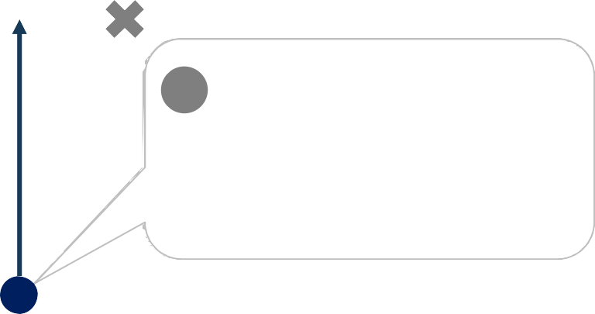
The problem side ▶ Types of Machine Learning problems
Typically, we then want to “fit some function through your data” so that you can use the function itself to predict (unseen) values
Regression (I / II)
Massively simplified
response variable (e.g. rent)
1
Here it seems a straight line can describe the relation quite well
2
Now, we can use the identified relation to predict the rental price given only the size of a flat
a feature (e.g. size)

Slide 30
The problem side ▶ Types of Machine Learning problems
From the general type of learning we can go one level deeper and distinguish different categories of Machine Learning problems
Overview of ML problems
Not exhaustive
Machine Learning
General types of learning
Supervised learning
“Here is the data set where the right answers (labels) are given for each example. Please produce more right answers.”
Unsupervised learning
“Here is the unlabelled data. Please find peculiarities, similarities or structures (e.g. clusters) in the data yourself.”
Reinforcement learning
“Learn to do something yourself purely by maximizing your expected reward.”
General types of problems
Regression
“Predict a continuous valued output.”
Clustering
„Group similar examples into subsets – called clusters“
…
Classification
“Predict a discrete valued output (e.g. a label or a class)”
Dimensionality reduction
„Maybe you don‘t need all the data. What is the essence of the data?“
This can be a goal on its own but is often used as a pre-processing step for other ML tasks
…

Slide 31
The problem side ▶ Types of Machine Learning problems
In a classification problem, you are given labelled data and need to predict the correct class for a new (un-labelled) example
Classification
Massively simplified
One feature (e.g. weight)
Classes:
= Rat
= Mole
Please note that in classification problems, we typically do not have an axis for the response variable (because we are predicting discrete values where an axis does not make sense)
This is a new data point. We would like to know if this animal is a rat or a mole.
Another feature (e.g. body length)

Slide 32
The problem side ▶ Types of Machine Learning problems
Again, we need to “fit some function to the data” – but this time the function shall represent the boundary between the classes
Classification
Massively simplified
One feature (e.g. weight)
Classes:
= Rat
= Mole
One possible boundary – this would make our new data point a “mole”
Another feature (e.g. body length)

Slide 33

The problem side ▶ Types of Machine Learning problems
In a clustering problem, you do not have any labelled data – all you have is un-labelled data points
Clustering
Massively simplified
One feature (e.g. customer age)
How many and what kind of customer groups should we distinguish?
Maybe 3 when we only consider these 2 features…?
Another feature
(e.g. average ticket size)

Slide 34

The framework for this workshop
In our framework, we have now covered the problem side
Problem side
T
y
p
e
s
o
f
(
M
a
c
h
i l
A
n
e
)
e
a
r
n
i
n
g
 
S
u
p
e
r
v
i
s
e
d
U
n
s
u
p
e
r
v
i
s
e
d
R
e
i
n
f
o
r
c
e
m
e
n
t
L
e
a
r
n
i
n
g
L
e
a
r
n
i
n
g
L
e
a
r
n
i
n
g
 
B
T
y
p
e
s
o
f
(
M
a
c
h
i
n
e
L
e
a
r
n
i
n
g
)
p
r
o
b
l
e
m
s
R
e
g
r
e
s
s
i
o
n
l
i
C
u
s
t
e
r
i
n
g
…
C
l
a
s
s
i
f
i
c
a
t
i
o
n
D
m
.
R
e
d
u
c
t
i
o
n
…

Slide 35
AGENDA
Scope of this talk
Recent examples of Machine Learning
Definition and promises of Machine Learning
The framework for this learning session
“The problem side”
“The solution side” ➔ Overview of Machine Learning algorithms
Training (“fitting”), validating and testing
Model Selection
Wrap-up

Slide 36
The solution side ▶ Overview of Machine Learning algorithms
There are literally thousands of Machine Learning algorithms –
it is impossible to know and understand them all
Selection of Machine Learning algorithms and families
Far from being ‘MECE’
Decision trees
K-nearest neighbour (KNN)
Perceptron
Artificial Neural Networks (ANN)
Unsupervised Neural network models (“Restricted Boltzmann machines“)
Deep belief networks
Random Forests
Linear Regression
Ordinary least squares (OLS)
Penalised regression
Principal Component Analysis (PCA)
Randomised PCA
Logistic Regression
(Linear / Quadratic) Discriminant Analysis
Support Vector Machines (SVM)
(Linear) Support Vector Classifier (SVC)
Support Vector Regression
Naive Bayes
K-means
Independent Component Analysis (ICA)
Non-negative matrix factorisation (NMF)
IsoMap
Association analysis
Hidden Markov Model
Kernel Approximation
MeanShift
Recurrent neural networks
Novelty and Outlier Detection
Density Estimation
Gaussian mixture models (GMM)
Manifold learning
Spectral Embedding (“Laplacian Eigenmaps“)
Deep Learning
Locally linear embedding (LLE)
Hessian-based LLE (“Hessian Eigenmapping“)
Multi-dimensional Scaling (MDS)
Bayes nets
Latent linear models
Sparse Bayesian Learning
Gaussian processes
CART
AdaBoost
LogitBoost
Polynomial Regression
State space models
Markov random fields
Convolutional neural networks
Conditional random fields (CRF)
Monte Carlo inference
Markov Chain Monte Carlo (MCMC) inference
Latent variable models
Latent Dirichlet allocation (LDA)
(Linear) Stochastic gradient descent (SGD) classifier
Gaussian Naive Bayes Classifier
…and thousands more…

Slide 37
Regression | Instance-based Methods | Regularization Methods | Decision Tree Learning
Regression is concerned with modelling the relationship between variables that is iteratively refined using a measure of error in the predictions made by the model. Regression methods are a work horse of statistics and have been cooped into statistical machine learning. This may be confusing because we can use regression to refer to the class of problem and the class of algorithm. Really, regression is a process. | Instance based learning model a decision problem with instances or examples of training data that are deemed important or required to the model. Such methods typically build up a database of example data and compare new data to the database using a similarity measure in order to find the best match and make a prediction. For this reason, instance based methods are also called winner take all methods as well as case based and memory based learning. Focus is put on representation of the stored instances and similarity measures used between instances. | An extension made to another method (typically regression methods) that penalizes models based on their complexity, favoring simpler models that are also better at generalizing. I have listed Regularization methods here because they are popular, powerful and generally simple modifications made to other methods. | Decision tree methods construct a model of decisions made based on actual values of attributes in the data. Decisions fork in tree structures until a prediction decision is made for a given record. Decision trees are trained on data for classification and regression problems.
Ordinary Least Squares Linear Regression Logistic Regression Stepwise Regression Multivariate Adaptive Regression Splines (MARS) Locally Estimated Scatterplot Smoothing (LOESS) | K-Nearest Neighbor (kNN) Learning Vector Quantization (LVQ) Self-Organizing Map (SOM) | Ridge Regression Least Absolute Shrinkage and Selection Operator (LASSO) Elastic Net | Classification and Regression Tree (CART) Iterative Dichotomizer 3 (ID3) C4.5 Chi squared Automatic Interaction Detection (CHAID) Decision Stump Random Forest Multi-variate Adaptive Regression Splines (MARS) Gradient Boosting Machines (GBM)
Bayesian | Kernel Methods | Clustering Methods | Association Rule Learning
Bayesian methods are those that are explicitly apply Bayes' Theorem for problems such as classification and regression. | Kernel Methods are best known for the popular method Support Vector Machines which is really a constellation of methods in and of itself. Kernel Methods are concerned with mapping input data into a higher dimensional vector space where some classification or regression problems are easier to model. | Clustering, like regression describes the class of problem and the class of methods. Clustering methods are typically organized by the modelling approaches such as centroidbased and hierarchical. All methods are concerned with using the inherent structures in the data to best organize the data into groups of maximum similarity. | Association rule learning are methods that extract rules that best explain observed relationships between variables in data. These rules can discover important and commercially useful associations in large multidimensional datasets that can be exploited by an organization.
Naive Bayes Averaged One-Dependence Estimators (AODE) Bayesian Belief Network (BBN) | Support Vector Machines (SVM) Radial Basis Function (RBF) Linear Discriminate Analysis (LDA) | K-Means Expectation Maximization (EM) | Apriori algorithm Eclat algorithm
Artificial Neural Networks | Deep Learning | Dimensionality Reduction | Ensemble Methods
Artificial Neural Networks are models that are inspired by the structure of biological neural networks. They are a class of pattern matching method that are commonly used for regression and classification problems but are really an enormous subfield comprised of hundreds of algorithms and variations for all manner of problem types. | Deep Learning methods are a modern update to Artificial Neural Networks that exploit abundant cheap computation. The are concerned with building much larger and more complex neural networks, and many methods are concerned with semi-supervised learning problems where large datasets contain very little labelled data. | Like clustering methods, Dimensionality Reduction methods seek and exploit the inherent structure in the data, but in this case in an unsupervised manner or order to summarize or describe data using less information. This can be useful to visualize high dimensional data or to simplify data which can then be used in a supervised learning method. | Ensemble methods are models composed of multiple weaker models that are independently trained and whose predictions are combined in some way to make the overall prediction. Much effort is put into what types of weak learners to combine and the ways in which to combine them. This is a very powerful class of techniques and as such is very popular.
Perceptron Back-Propagation Hopfield Network Self-Organizing Map (SOM) Learning Vector Quantization (LVQ) | Restricted Boltzmann Machine (RBM) Deep Belief Networks (DBN) Convolutional Network Stacked Auto-encoders | Principal Component Analysis (PCA) Partial Least Squares Regression (PLS) Sammon Mapping Multidimensional Scaling (MDS) Projection Pursuit | Bagging Bootstrapped Aggregation (Boosting) AdaBoost Stacked Generalization (blending) Gradient Boosting Machines (GBM) Random Forest

Slide 38
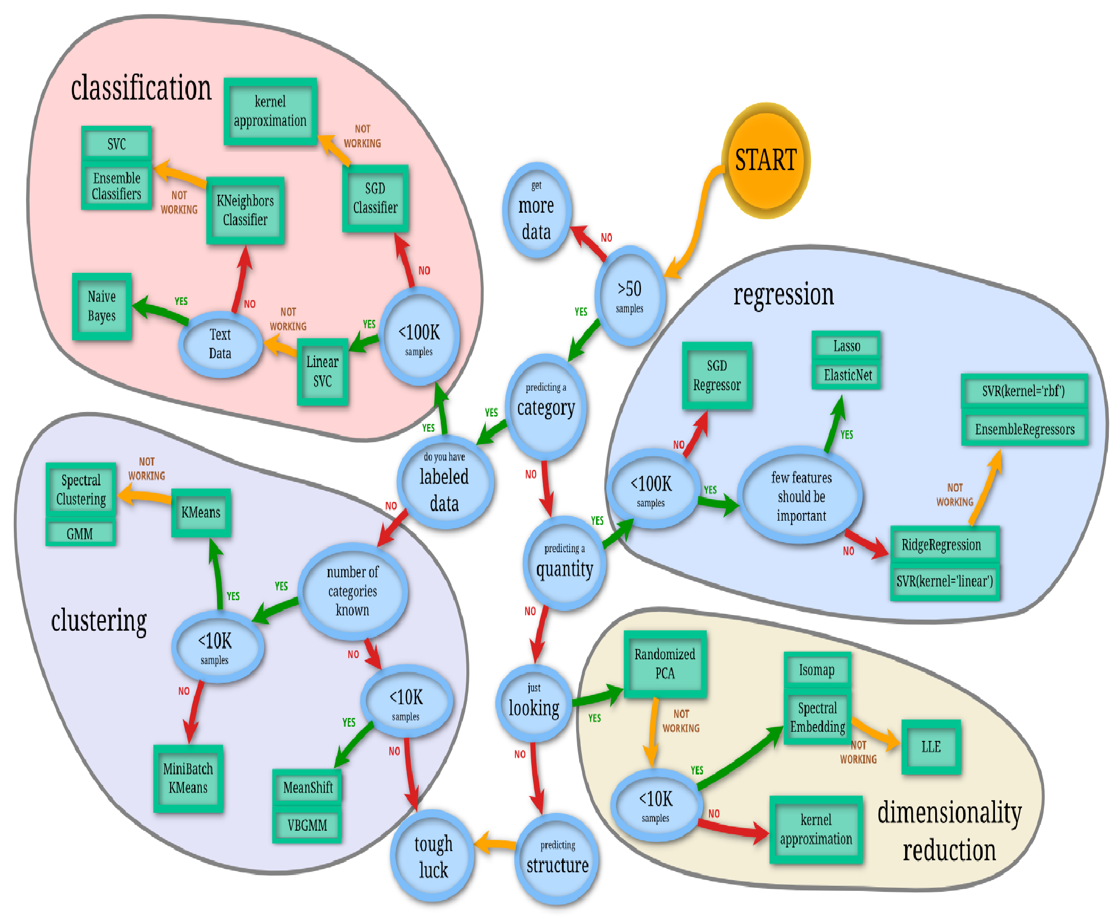
The solution side ▶ Overview of Machine Learning algorithms
‘scikit learn’ (a Machine Learning library in Python) provides a useful cheat sheet for some of the main algorithm families
Source: http://scikit-learn.org/stable/tutorial/machine_learning_map/

Slide 39
AGENDA
Scope of this talk
Recent examples of Machine Learning
Definition and promises of Machine Learning
The framework for this learning session
“The problem side”
“The solution side” ➔ Selected algorithm concepts
Training (“fitting”), validating and testing
Model Selection
Wrap-up

Slide 40


The solution side ▶ Overview of Machine Learning algorithms
The basic idea of some Machine Learning algorithms can be explained in a single picture: kNN is a very simple idea for classifying an example
Massively simplified
Problem
Basic idea to solve it
another feature
another feature
some feature
some feature
I want to classify my data
I already have some correct classifications (what type of learning is this?)
Now I got this new example that I need to classify
Which class should it be?
Why don‘t you use a majority vote of the nearest, let‘s say 3, labelled examples?
k nearest neighbours (kNN)

Slide 41
The solution side ▶ Overview of Machine Learning algorithms
The basic idea of some Machine Learning algorithms can be explained in a single picture…
Massively simplified
Problem
Basic idea to solve it
another feature
another feature
some feature
some feature
Listen, I have got these data points that have already been assigned to classes (what type of learning is this?)
Now I want to put a line between them so that I can classify new examples
Ok, why don‘t you put the line in there such that the margin between the closest points and the line is maximal?
Linear Support Vector Classifier

Slide 42
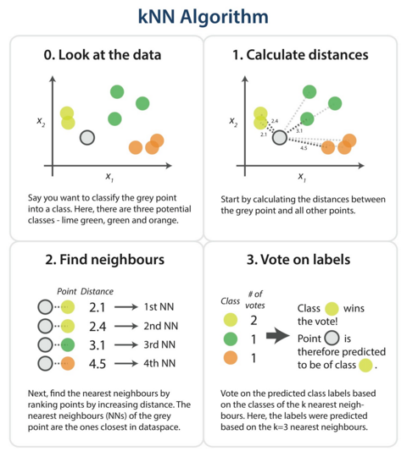

Slide 43
The solution side ▶ Overview of Machine Learning algorithms
An artificial neuron is the building block for Neural Networks / Deep Learning
Artificial neuron (I / II)
Massively simplified
“features”
“response variable”
weight₁
input₁ input₂ input₃
weight₂
weight₃
…
weight_{n}
output
input_{n}
bias

Slide 44
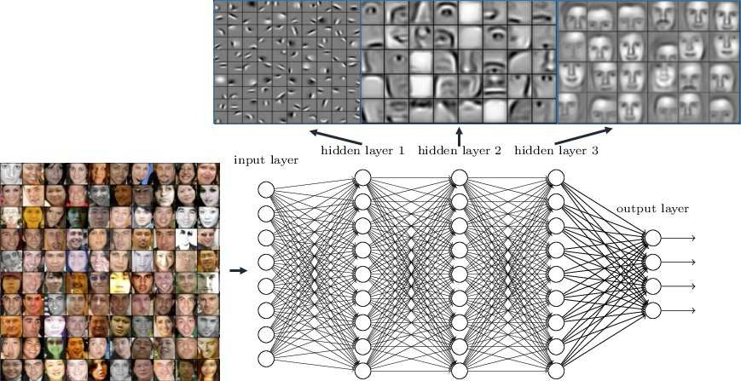
The solution side ▶ Overview of Machine Learning algorithms
A single neuron itself is not very exciting – the magic happens when you use multiple neurons in parallel and then use multiple layers of these
Source: Taken from http://www.rsipvision.com/

Slide 45
AGENDA
Scope of this talk
Recent examples of Machine Learning
Definition and promises of Machine Learning
The framework for this learning session
“The problem side”
“The solution side”
Training (“fitting”), validating and testing
Model selection
Wrap-up

Slide 46
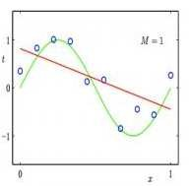
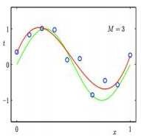
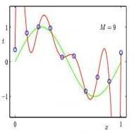

Training (“fitting”), validating and testing
When fitting a regression model to the data, we can make the model infinitely complex simply by increasing the degree of the polynomial
Under- vs. overfitting (regression)
Supervised learning only
Underfitting
Appropriate
Overfitting
= actual data
= our model
1st degree (linear)
3rd degree (cubic)
9th degree
Every single data point is on the line.
But does this reflect the underlying truth?
Model complexity
Source: Over- / underfitting drawings taken from http://www.inf.ed.ac.uk/teaching/courses/iaml/slides/eval-2x2.pdf

Slide 47
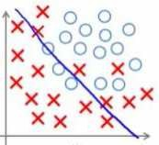
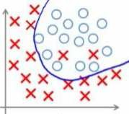
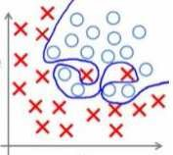

Training (“fitting”), validating and testing
The same is true for classification – we can make our decision boundary infinitively complex
Under- vs. overfitting (regression)
Supervised learning only
Underfitting
Appropriate
Overfitting
= Example from class 0
= Example from class 1
Nice fit with the training data. We have not made a single mistake!
But what if we get new data?
Model complexity
Source: Over- / underfitting drawings taken from http://www.inf.ed.ac.uk/teaching/courses/iaml/slides/eval-2x2.pdf

Slide 48
Training (“fitting”), validating and testing
There is a (bias-variance) trade-off when fitting a model to the data –
we can under-fit or over-fit our learner to the data
Under- vs. overfitting (regression)
Supervised learning only
Underfitting
Just right
Overfitting
High
There is more to be learnt that you have not made use of
When testing the model, you will observe a high approximation error (bias)
Fitting the model even to the noise / the model now reflects all the quirks in the data
When testing the model, you will observe high variance (variation between data sets)
Prediction error
on new (unseen) data
Prediction
error
Optimum
Prediction error
on the data we train with
Low
Model complexity
High

Slide 49
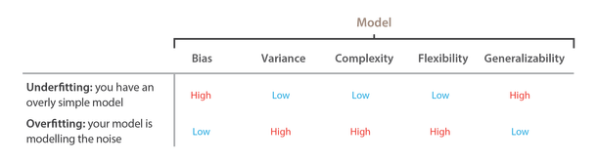
Training (“fitting”), validating and testing
There is a (bias-variance) trade-off when fitting a model to the data –
we can under-fit or over-fit our learner to the data

Slide 50


Training (“fitting”), validating and testing
In order to prevent overfitting, the available data is typically split into three partitions: for training, validation and for testing
Supervised learning only
Available data
Training
(~“questions in class“)
Validation
(~“homework“)
Testing
(~“exam“)
This performance is what really matters in the end.
Check your training (and tune your hyperparameters) with this data partition.
But if you train on this, you are effectively cheating.

Slide 51
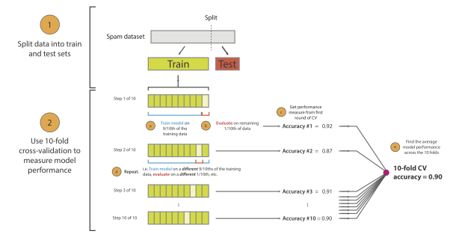
Training (“fitting”), validating and testing
For model evaluation, it is better to test more than once using cross-validation techniques

Slide 52
AGENDA
Scope of this talk
Recent examples of Machine Learning
Definition and promises of Machine Learning
The framework for this learning session
“The problem side”
“The solution side”
Training (“fitting”), validating and testing
Model selection
Wrap-up

Slide 53
Model Selection
In order to finalize on a model, hyperparameters have to be tuned
Supervised learning only
Model Selection

Slide 54
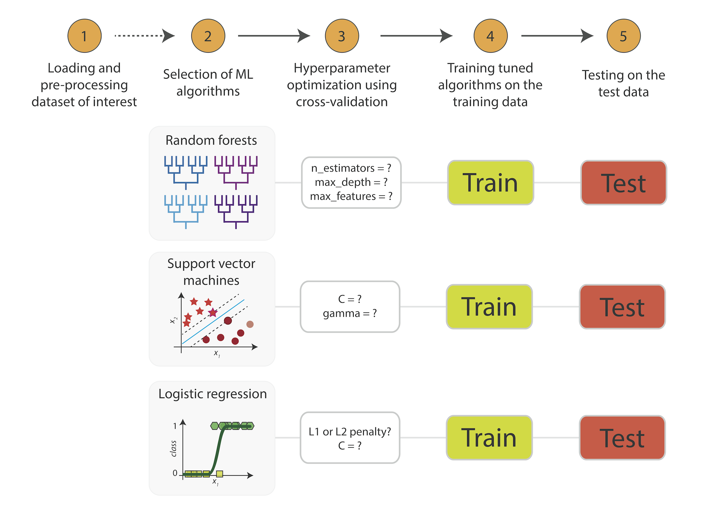
Model Selection
Hyperparameter optimization using cross-validation

Slide 55
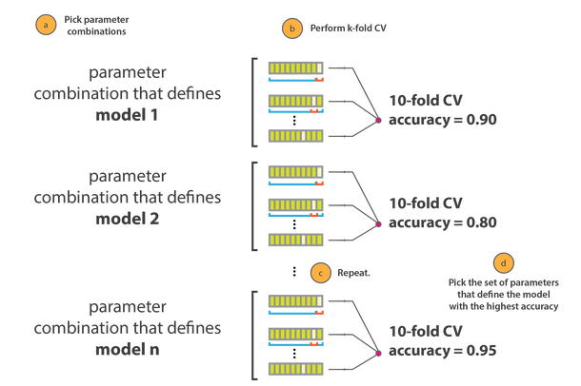
Model Selection
Finding the best model involves tuning the hyperparameters

Slide 56
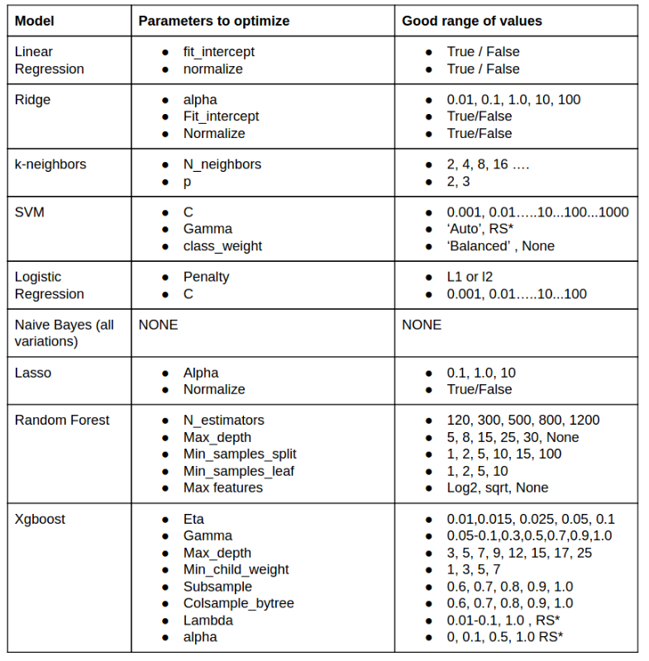
Model Selection
Hyperparameters of few estimators

Slide 57
Putting Data Science into Perspective

Slide 58
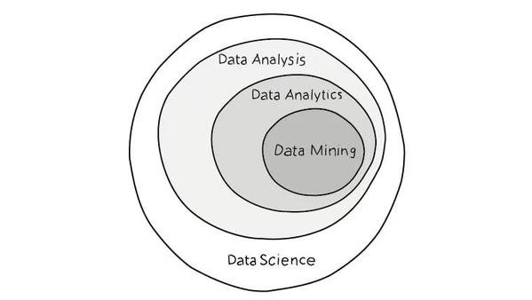
Data Science
The Context

Slide 59
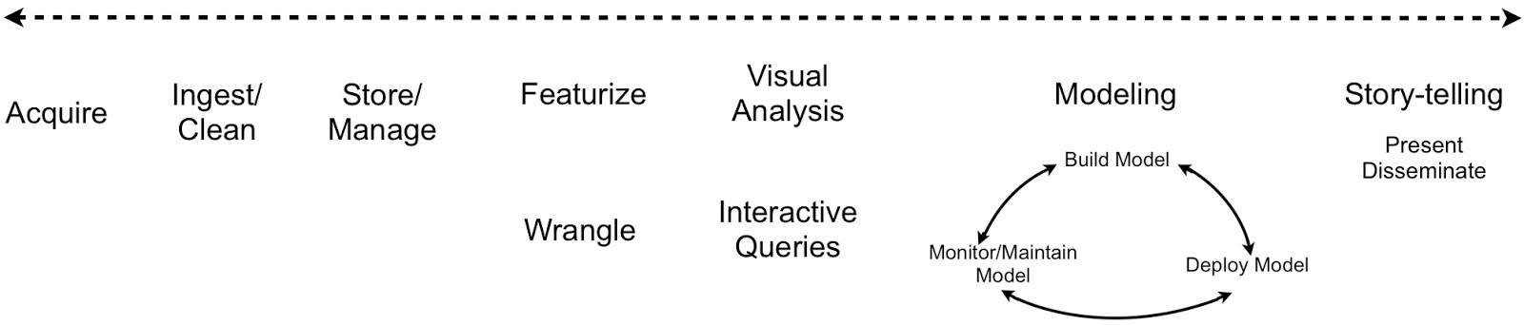
Data Science
The Workflow

Slide 60
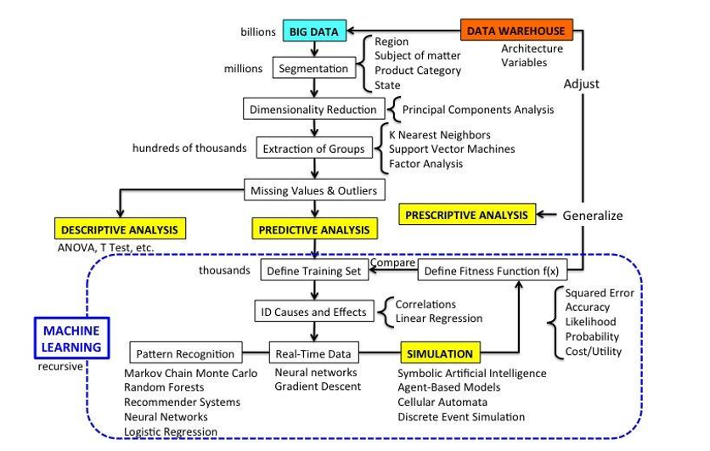
Data Science
Machine Learning applied to Big Data

Slide 61









Data Science
Modeling Overview
Machine Learning
A.I
“as we know it”
Q2 Q3
Q1 Q4
Data
Data Mining
Algorithmic
AI
Model Source
Human Learning
Parametric
Theory
Human Intelligence
“Causality” Simulation
Description
Association
Explanation
Optimization
Model Purpose
Prediction
Explanation

Slide 62
And there is one more…

Slide 63
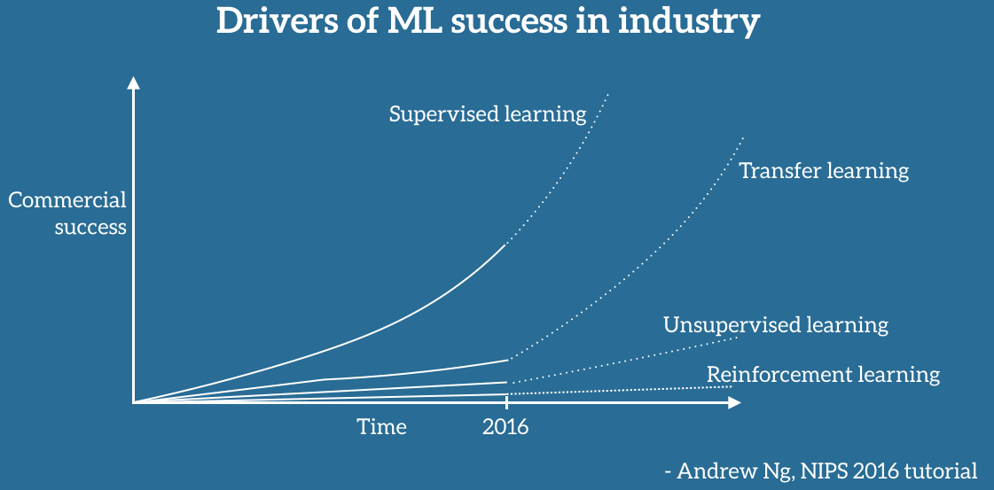
http://ruder.io/transfer-learning/

Slide 64
WRAP UP
Scope of this talk
Recent examples of Machine Learning
Definition and promises of Machine Learning
The framework for this learning session
“The problem side”
“The solution side”
Training (“fitting”), validating and testing
Model Selection
Wrap-up

Slide 65


